Slide 1
SHORT-TERM INTERNSHIP ON ARTIFICIAL INTELLIGENCE
N.B.S.S NAGA LAKSHMI
23555A0508
CSE-B

Slide 2
CONTENTs
Abstract
Introduction
Applications
Tasks
Outputs
Conclusion

Slide 3
ABSTRACT
The Internship aimed to explore the forefront of artificial intelligence and technologies at the Artificial Intelligence Medical and Engineering Researchers Society (AIMER Society) focused on Generative AI, computer vision, chatbot development, and visual question answering. Initially concentrated on computer vision, covering techniques in image processing , image classification and object detection.
Additionally, examined various AI tools and techniques, including the use of advanced models and practical applications including COLAB,YOLO,GEMINI,ROBOFLOW, POWERBI, etc..

Slide 4
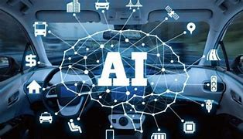
ARTIFICIAL INTELLIGENCE
Artificial Intelligence (AI) refers to the simulation of human intelligence in machines that are programmed to think and learn like humans. AI systems are designed to perform tasks that typically require human intelligence, such as understanding natural language, recognizing patterns, solving problems, and making decisions.

Slide 5
APPLICATIONS
Artificial Intelligence has various applications in today's society. It is becoming essential for today's time because it can solve complex problems with an efficient way in multiple industries, such as Healthcare, entertainment, finance, education, etc. AI is making our daily life more comfortable and fast.

Slide 6
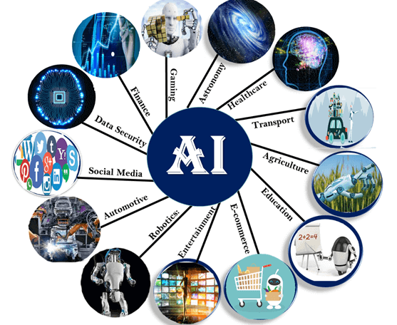
Following are some sectors which have the application of Artificial Intelligence:

Slide 7
tasks
Chat Bot
Object Detection
Data Visualization using Power BI
Image classification
Talking parrot
Visual Question & Answering

Slide 8
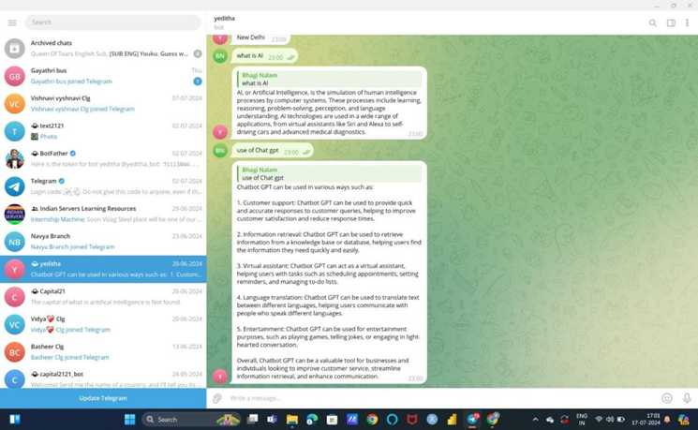
Chatbot:
Creating a Telegram Bot
BotFather: To create a bot, you need to interact with the BotFather, a special bot on Telegram that helps you create and manage other bots. You can find it by searching for “BotFather” on Telegram.
Get an API Token: Once you’ve set up your bot with BotFather, you’ll receive an API token. This token is crucial for interacting with Telegram’s API and should be kept secure.

Slide 9
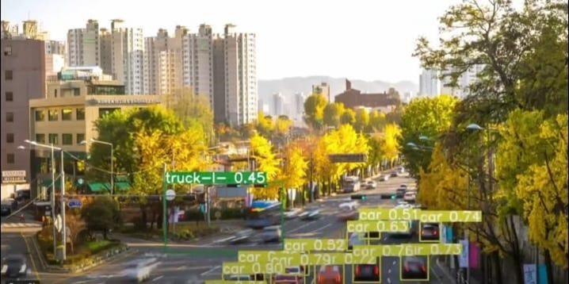
Object detection
Object detection is a computer vision technique that involves identifying and locating objects within an image or video. It’s a critical task in various applications such as autonomous driving, facial recognition, and security surveillance.

Slide 10
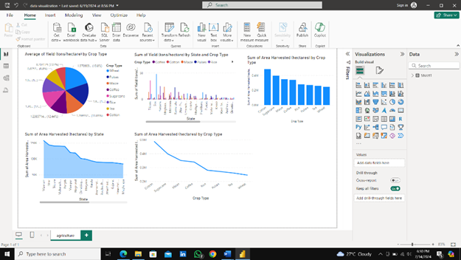
Data visualization (using power bi)
Data visualization is the graphical representation of information and data. It involves creating visual contexts, such as charts, graphs, and maps, to help understand complex data, identify patterns, trends, and insights.

Slide 11
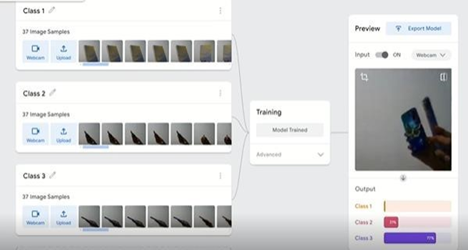
image classification
Image classification is a subset of machine learning and computer vision where the goal is to categorize images into predefined classes. Here's a detailed look at the process, techniques, and applications of image classification

Slide 12
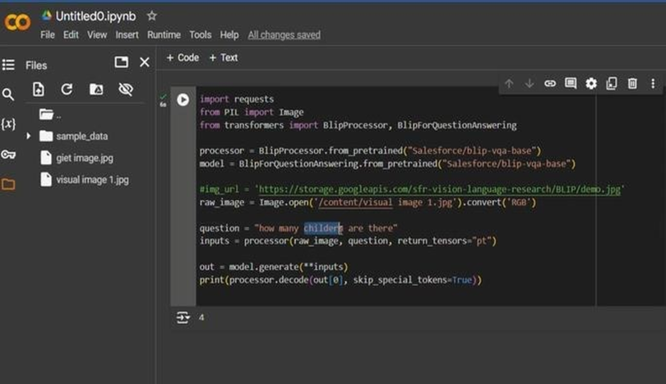
Visual question and answering
Visual Question Answering (VQA) is an interdisciplinary field in artificial intelligence that combines computer vision and natural language processing to answer questions about images. It involves understanding and interpreting both the visual content of an image and the textual content of a question to generate an accurate response.

Slide 13
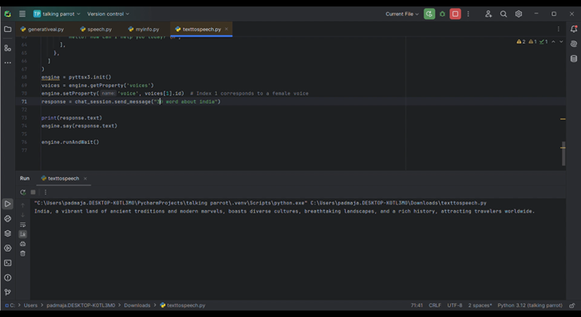
Talking parrot(by suing ai)
Creating an AI-powered talking parrot involves combining elements of natural language processing (NLP), speech synthesis, and perhaps some computer vision and robotics to mimic the behaviors of a parrot.

Slide 14
conclusion
I am from Computer Science and Engineering department. This AI internship can be incredibly valuable for building my career in Artificial Intelligence and Cyber Security. This internship helps me a lot that I can learned so many things from this internship like How to use the CHATGPT efficiently, how to detect objects using different models like YOLOv8, Some more different models, generative AI, CHATBOT development for telegram, creating a talking parrot, how to generate the images from the text with the help of DALL-E and this knowledge makes me to create a lot of things of my own.

Slide 15
Thank you!

